Slide 1
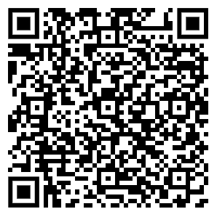
Hands-on lab
Fundamentals of Migration Engineering with OpenRewrite
Devoxx France 2024

Slide 2
01
Hi & why
02
Migrations & OpenRewrite
03
Concepts
04
Mix of demo & explanations
05
Next steps
Notes:
By myself, so can’t be walking around as much initially.
My plan is that I take you through a lot of different topics,
and then we evaluate where we are and you’re welcome to explore on your own.
If you want to go at your own pace, that’s fine too;
there’s links to the docs and video’s throughout, such that you don’t strictly need me.

Slide 3


Who here has heard of OpenRewrite?
Notes:
Was here two years ago;
gave my first ever 15 minute presentation

Slide 4

Who here has used OpenRewrite?
Notes:
Might have used it in Spring Boot migration,
upgrading you to Spring Boot 3.x, Java 17, Jakarta & JUnit 5

Slide 5


Who here has heard of Moderne?
Notes:
Moderne builds upon OpenRewrite,
allowing you to run recipes at scale.
At Moderne we serialize the model of your code,
allowing for faster recipe runs, analysis and visualizations.

Slide 6
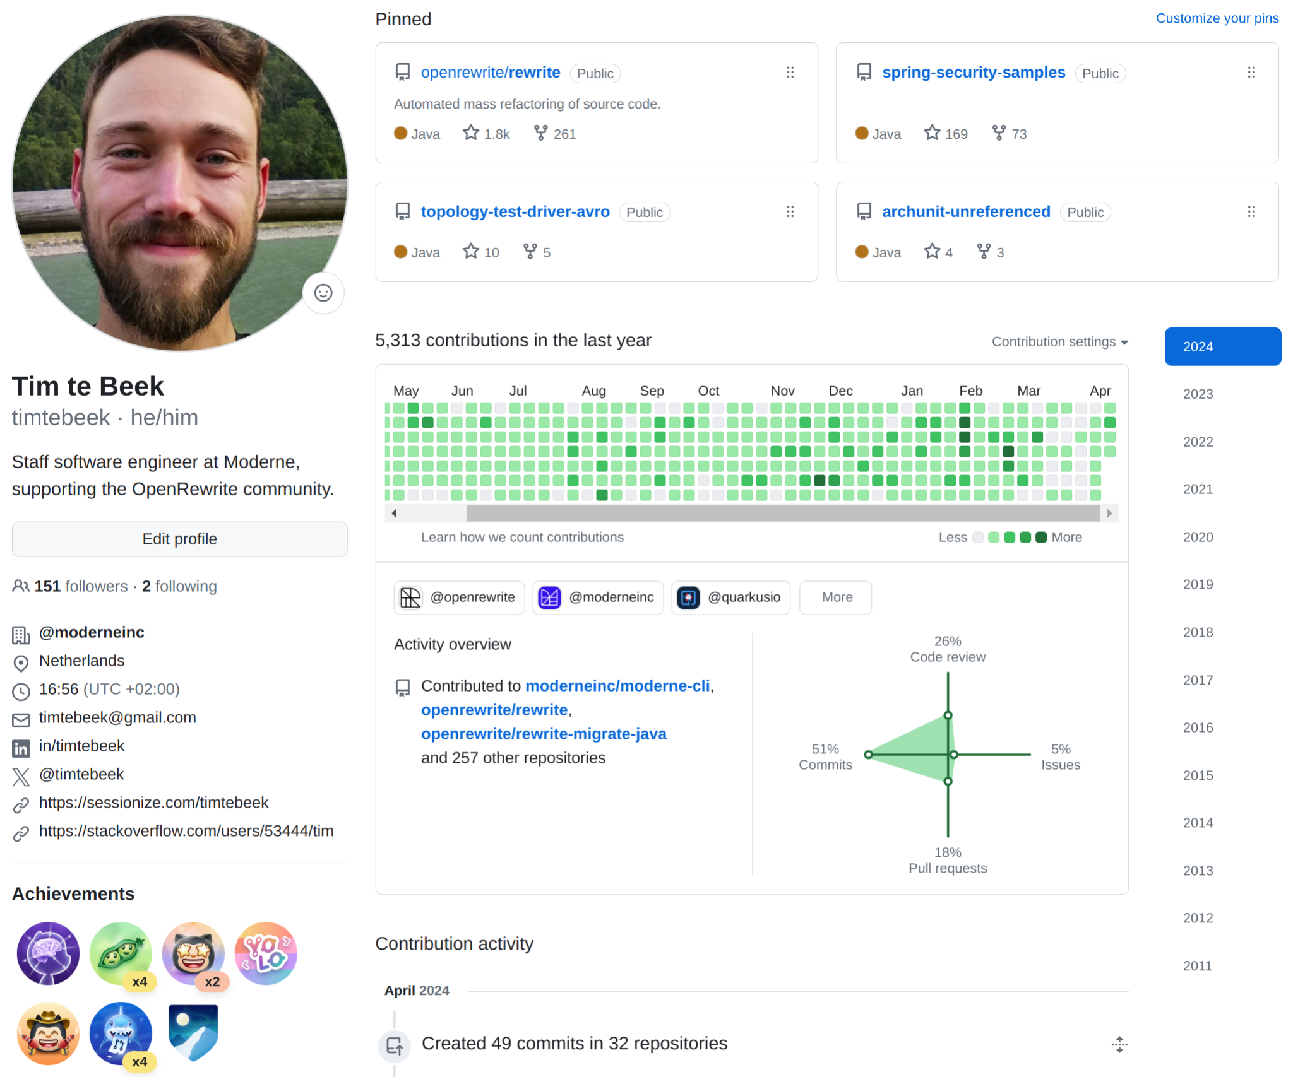
Notes:
Staff software engineer at Moderne, where I work on OpenRewrite and the Moderne CLI.
As you can see from my GitHub profile..
I like growing a beard while hiking,
and contributing to Open Source Software
Past couple of years those contributions have been on the theme of using OpenRewrite to automate code changes on Open Source Software.
But even before that I’ve been Modernizing applications for years and years,
in a previous job as a consultant.

Slide 7

You want a promotion, to travel/retire somewhere tropical
Your company promotes folks who deliver features
You’re held up by technical debt
Automation helps you get back to features & the tropics
Notes:
Today we’ll look at migration engineering, from the perspective of OpenRewrite.
But why would anyone care? Your manager typically has different priorities.
Not a stock photo though

Slide 8
01
Vulnerabilities
Technical debt
02
Performance
03
Bugs
04
Hiring & retention
05
Automation helps
Notes:
Why would you be looking to Modernize?
It works? Maybe best not to touch it?
Well you likely have to anyway; because of vulnerabilities.
These can be quite disruptive…
And you don’t want to read the Spring Boot migration guides at 2am.
You can also get double digit performance improvements just by upgrading your Java version.
By automating away bugs it’s easier to focus on work that really matters.
If you’re looking to hire, or retain colleagues, it’s best not to ask them to work with Java 8.
And finally, there’s automation here to help; this would be a pretty boring presentation otherwise.

Slide 9
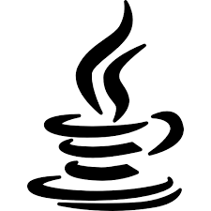


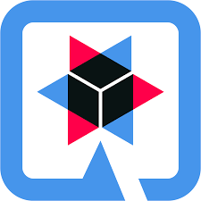

New releases
Spring, Quarkus, Micronaut
Every 6 months
Every 6 months
Every month
Notes:
Ever accelerating

Slide 10

The accumulated technical debt of software has grown to approximately $1.52 trillion.
CISQ: The Cost of Poor Software Quality in the US: A 2022 Report
Notes:
There’s is a lot of accumulated technical debt in our industry;
We’ve all seen examples; most of us have even contributed.
Automation up to recently had only bumped the odd version number.
And artificial intelligence is only going to make matters worse;
trained on outdated patterns; producing ever more legacy code.
—
The growing impact of Technical Debt has become the biggest obstacle to making changes to existing codebases. One report cites technical debt as a $1.5 trillion problem in the US. That same report also says that by 2025, 40% of IT budgets will be spent simply maintaining technical debt.
There’s the technical debt that developers work at every day (that’s what you can see on the exposed iceburg), and then there’s the under the surface debt — the deferred maintenance and upgrades — including older framework versions reaching end of life and security vulnerabilities waiting to be exposed. These issues too often show up on a critical path as a major migration project that could take months to complete or an urgent remediation due to a security breach.
Technical debt is expensive to maintain, and it comes at a significant opportunity cost for the business. It makes code harder to update and evolve — and much harder to build new innovative features. It can also be a top contributor to why software modernization projects fail.
---------------------------------------
CIOs estimate that tech debt amounts to 20 to 40 percent of the value of their entire technology estate
https://www.mckinsey.com/capabilities/mckinsey-digital/our-insights/breaking-technical-debts-vicious-cycle-to-modernize-your-business
CIOs estimated that tech debt amounts to 20 to 40 percent of the value of their entire technology estate before depreciation. For larger organizations, this translates into hundreds of millions of dollars of unpaid debt.
Allocate less than 20% of budget to paying down tech debt on top of project costs. That could be dollars dedicated to new products that’s diverted to resolving issues related to tech debt.
As complexity builds future projects become more difficult.
The principal is all the work that must be done to modernize the entire technology stack. This includes deferred maintenance or upgrades below the app layer, modifications to comply with data standards, and bespoke packaged software (that is, customizations that take software beyond the point where the original vendor can easily provide ongoing support).
The interest is the complexity tax that every project pays today. It derives from the need to work through fragile point-to-point or batch data integrations, harmonize nonstandard data, and create workarounds to confront risk and meet business needs. These frictional losses inhibit companies’ long-term velocity and productivity and harm current budgets and returns on investment.

Slide 11
OpenRewrite
Notes:
Today we’re going to look at tackling technical debt with OpenRewrite.
OpenRewrite is a framework for safe code modifications.

Slide 12




What Moderne does
Manage codebases at scale
Examples
Software migration engineering coordinating among repositories
Migrate from Java 8 to 11 to Java 17 to Java 21 in all relevant repositories and infrastructure. Eliminate vendor lock-in by automating technology changes—for example, from one database to another.
We analyze and fix the source code automatically, so developers don’t have to.
Software
architect
Security vulnerability remediation across a growing attack surface
Eradicate OWASP Top 10 vulnerabilities immediately across a codebase with in-depth code analysis and auto-repair. Upgrade vulnerable dependencies automatically.
Security engineer
Improving code quality and compliance across an organization
Repair SAST issues automatically (reported by SonarQube, FindBugs, HP Fortify, etc.). Keeping code clean all the time makes it easier to work with and maintain.
Developer
Notes:
Migration engineering is a real pain point for many organizations. Large-scale code migrations can take an engineering team months or years to implement because of the dependencies and unknown amount of code changes. This makes it extremely difficult to scope the time and cost of these updates, which leads to under-scoped and ineffective efforts. What’s more, developers tend to fear version updated because they are unsure how long it will take to get an application back in a functioning state. No other vendor on the market can address the code migration use case. We also think of this as a two-fer – by keeping frameworks up to date, you essentially improve the security posture of the codebase.
Think of a large enterprise that might have 8000 or more repositories with the same security vulnerability… developers would typically have to step through each repository and fix each instance manually. With Moderne, we enable organizations to assess vulnerabilities across repositories – the full impact radius – and then run recipes to remediate.
And then there’s keeping code compliant with team and framework best practices, which is a continuous process. This can involve things like repairing issues reported by existing static analysis tools, removing unused dependencies, or updating internal URLs. These types of changes take developer time and effort that could be spent on business value work.

Slide 13
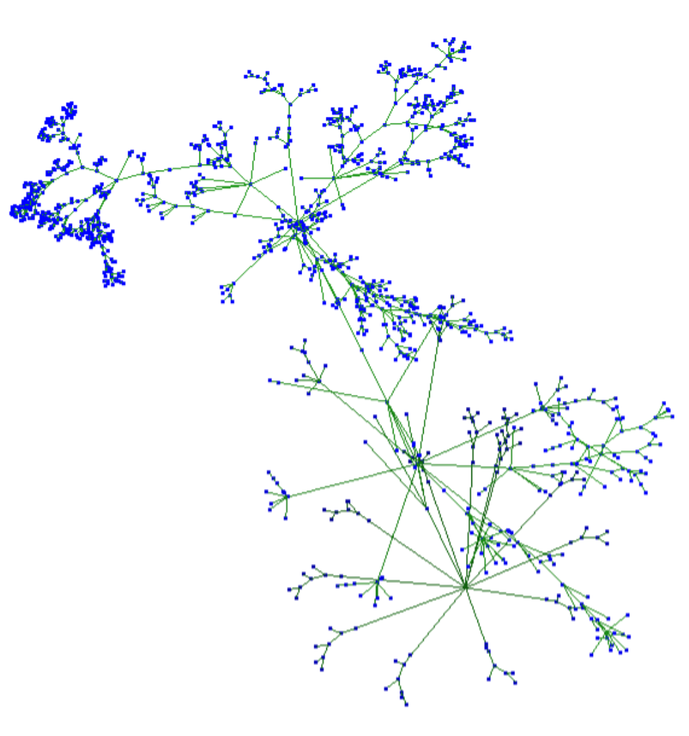
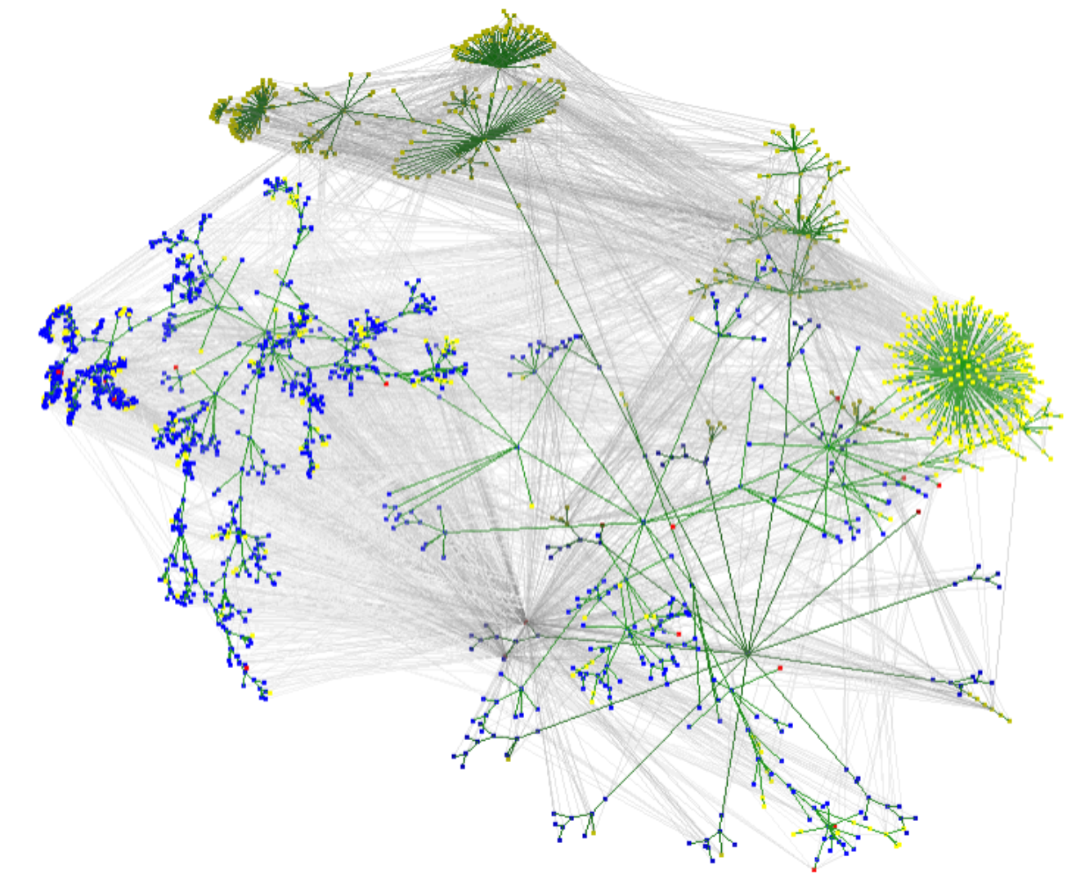
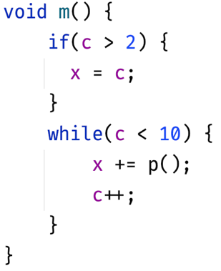
100% accurate, style-preserving transformation because of a tech leap in code representation
Text-based search
Abstract Syntax Tree (AST)
Lossless Semantic Tree (LST)
Characterized by serialization, type attribution, format preservation, and other metadata
+ another 600,000 nodes that didn’t fit in this graphic
Notes:
This sophisticated structural code representation contains rich semantic information of a codebase, enabling much more precise and accurate searches that greatly reduce the search volume to what’s really important.
It is characterized by type attribution, format preservation, and other metadata that is used to implement code analysis and transformation.
It can also be serialized, enabling us to traverse multiple LSTs to make holistic changes to the codebase. LSTs are output from the build process and stored alongside binaries. This triggers ingestion into the SaaS, so the code is available to work on a few minutes after being compiled. Moderne in effect is a data warehouse for code, where code is imported in a highly structured representation and queries and transformations can be executed in seconds at scale.

Slide 14
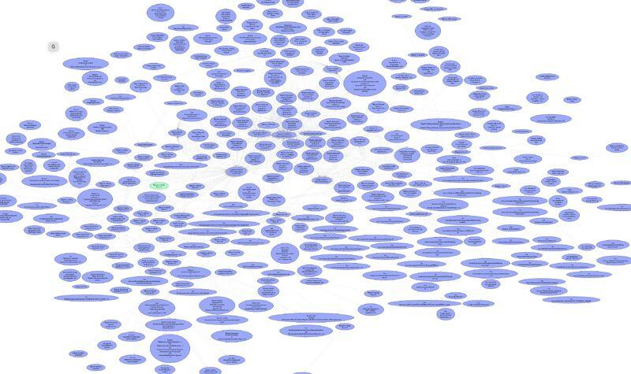
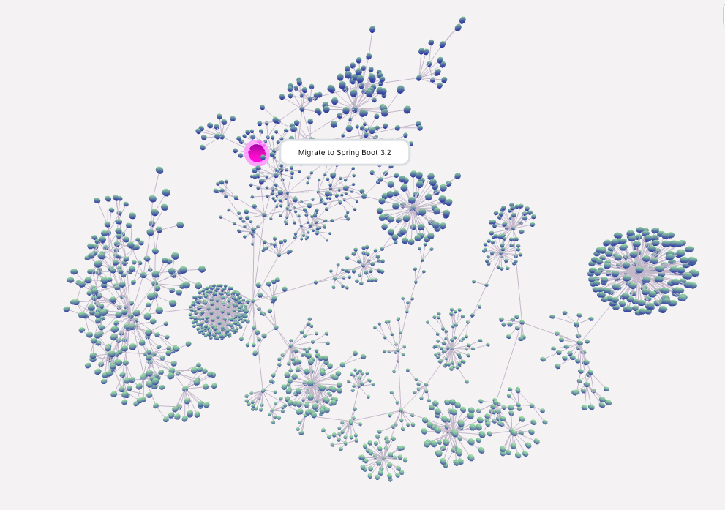
One migration, thousands of steps
To migrate to Spring Boot 3.2, it can take 2,013 steps.
Notes:
Large migrations changes are broken up into small reusable steps.
And this is why organizations fall behind on upgrades. It's quite expansive and difficult to manage.

Slide 15
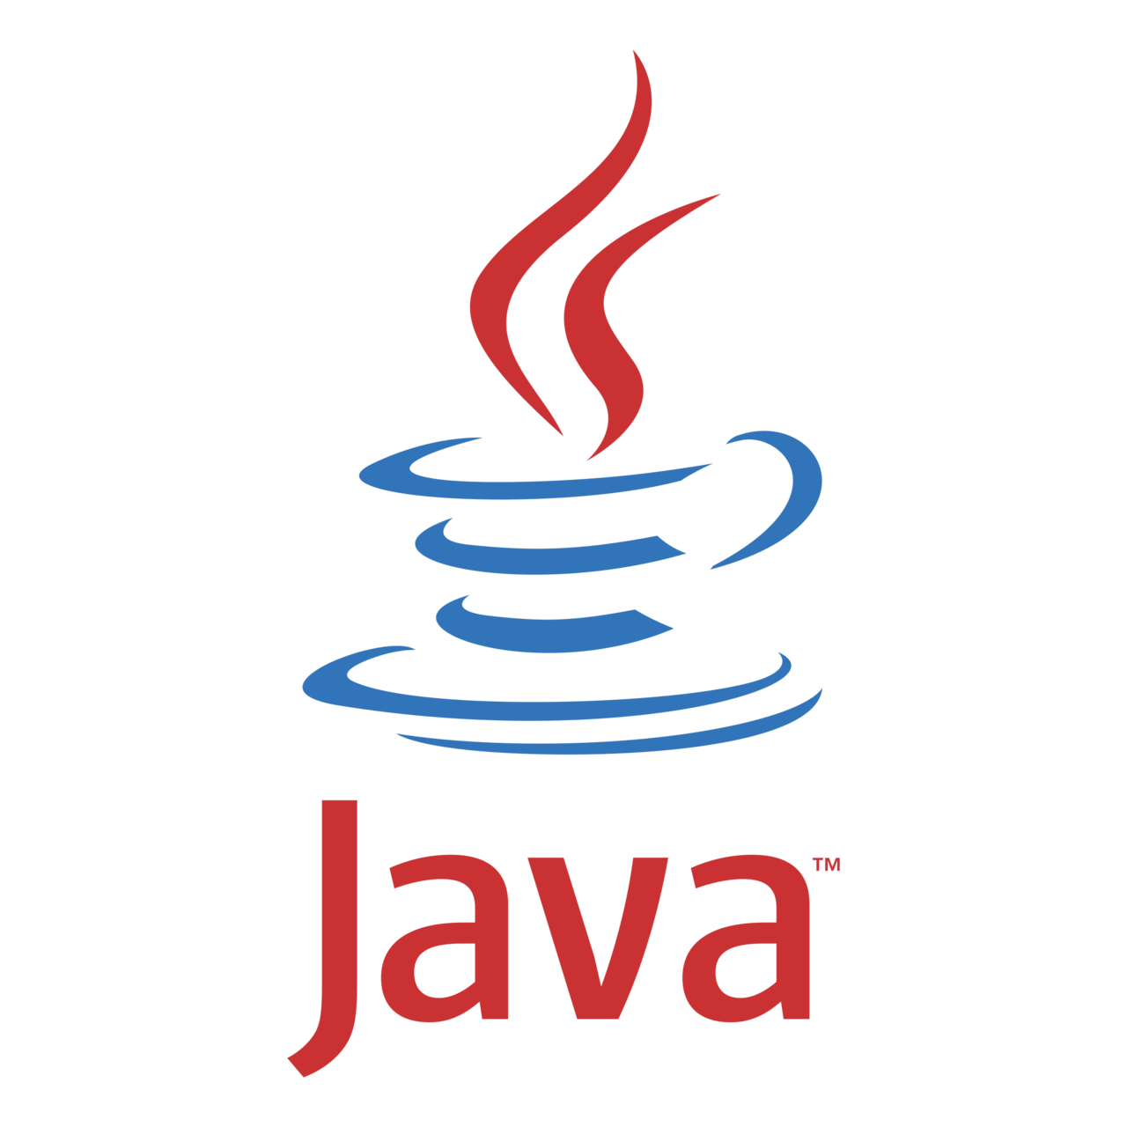



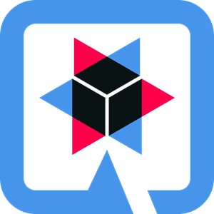






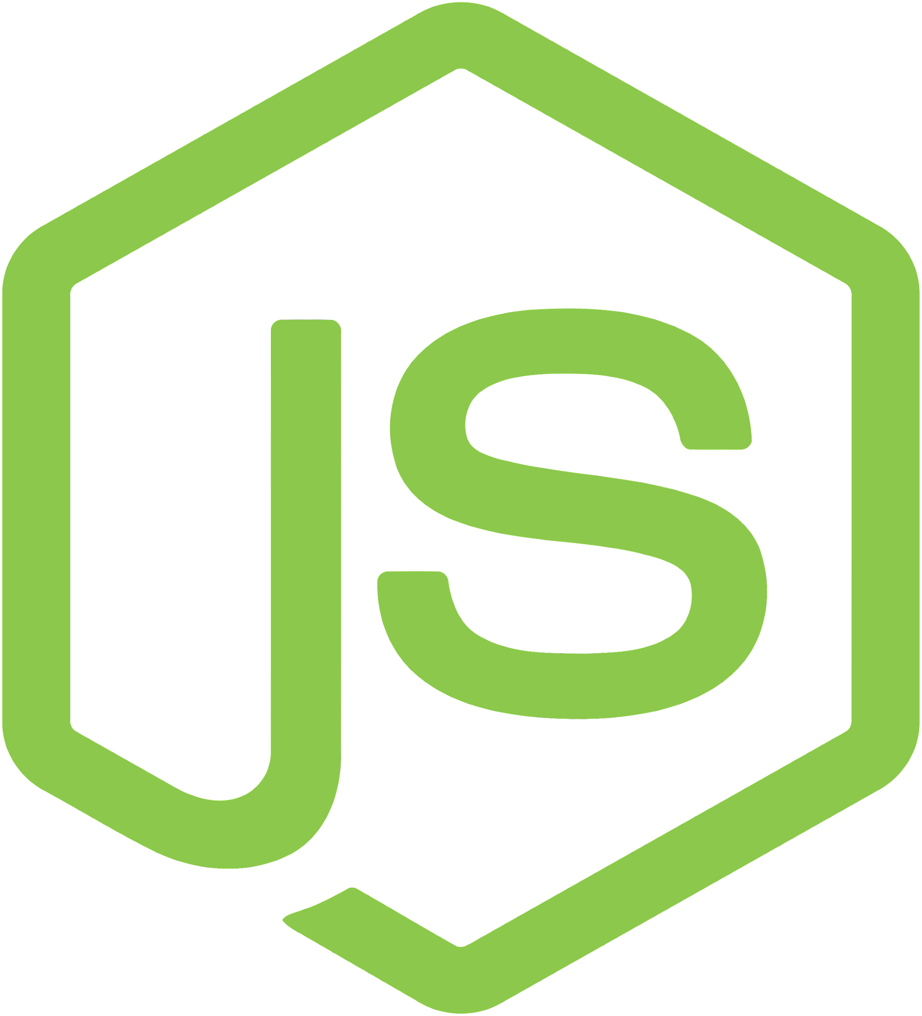















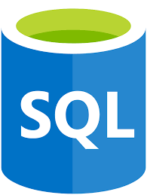
Growing ecosystem of modernization recipes
Languages
Frameworks, libraries, tooling
Infrastructure
Java-based
Apache Maven
Quarkus
Spring
Github Actions
Kubernetes
Terraform
Scripting
Gradle
AxonIQ Axon Framework
Micronaut
CircleCI
AWS
Microsoft Azure
Concourse
Google Cloud
Configuration
JHipster
Testcontainers
LaunchDarkly
Languages coming soon:
Python
TypeScript, JavaScript, Node.js
Recipes programmatically execute automated search and transformation actions on a codebase. The ecosystem of OpenRewrite community-driven recipes is continually growing.
Python
C# coming soon
Notes:
Recipes are another key component of the solution. They programmatically execute automated search and transformation actions on a codebase. As programs, they are infinitely flexible, able to encapsulate custom logic and build integrations. A recipe can represent a single, stand-alone operation or it can be linked together with other recipes to accomplish a larger goal such as a framework migration.
Recipe operations are run against the Lossless Semantic Tree to derive aggregated views for analysis and enact source code changes.
Recipes are built and maintained by the OpenRewrite ecosystem, including third-party and open-source software providers, as well as enterprise users. Companies can also build custom recipes for their own uses.
Java is our core language strength today, including Groovy and Kotlin, It’s one of the most popular languages in the world – and used extensively in existing enterprise applications – as well as new ones. But we also support a number of configuration languages, scripting languages, Cobol, and Python is in the works.
Java – language
Python – language
Groovy – language
Kotlin – language
JSON – language
YAML – language
XML – language
HashiCorp Configuration Language (HCL) – language
COBOL – language
SQL – relational database query language
Maven – build tool
Gradle – build tool
Jhipster – development platform
Testcontainers – library
AxonIQ - Axon Framework - framework
Spring – application framework
Quarkus – application framework
Micronaut – application framework
Github actions – CI/CD
Concourse – CI/CD
CircleCI – CI/CD
Kubernetes – infrastructure
Terraform – infrastructure
AWS – infrastructure
Azure – infrastructure
Google Cloud – infrastructure

Slide 16
Lossless Semantic Trees
docs.openrewrite.org/concepts-explanations/lossless-semantic-trees
docs.openrewrite.org/concepts-explanations/lst-examples
docs.openrewrite.org/concepts-explanations/tree-visiting-printer
Notes:
Importance of type attribution and format preservation

Slide 17

Recipes
docs.openrewrite.org/concepts-explanations/recipes
docs.openrewrite.org/authoring-recipes/types-of-recipes

Slide 18
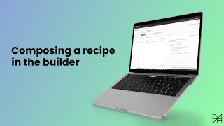
Declarative recipes
docs.openrewrite.org/reference/yaml-format-reference

Slide 19

IntelliJ 2024.1+ ultimate
plugins.jetbrains.com/plugin/23814-openrewrite
Notes:
Great way to run recipes, and create your own.

Slide 20
Demo in IntelliJ

Slide 21

Preconditions
docs.openrewrite.org/reference/yaml-format-reference#preconditions

Slide 22
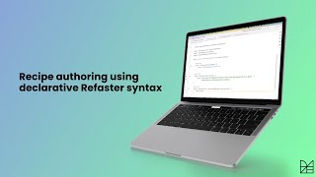
Refaster style recipes
docs.openrewrite.org/authoring-recipes/refaster-recipes

Slide 23
Demo rewrite-recipe-starter
Example recipe templates
Notes:
https://github.com/moderneinc/rewrite-recipe-starter?tab=readme-ov-file#rewrite-recipe-starter
Walkthrough NoGuavaListsNewArrayList and its tests, pointing out in particular:
MethodMatcher
Preconditions
JavaTemplate
Import manipulation
Importance of calling super.visit...(), by removing that call and showing how nested method invocations are no longer visited

Slide 24

Visitors
docs.openrewrite.org/concepts-explanations/visitors

Slide 25
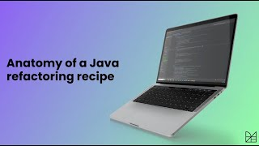
Writing recipes
docs.openrewrite.org/authoring-recipes/writing-a-java-refactoring-recipe

Slide 26

Recipe testing
docs.openrewrite.org/authoring-recipes/recipe-testing

Slide 27
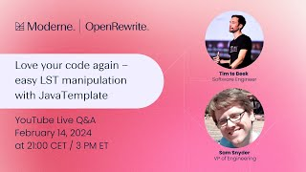
JavaTemplate
docs.openrewrite.org/concepts-explanations/javatemplate
docs.openrewrite.org/authoring-recipes/modifying-methods-with-javatemplate

Slide 28
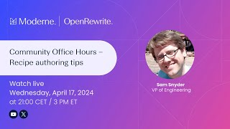
Recipe authoring tips
docs.openrewrite.org/authoring-recipes/recipe-conventions-and-best-practices

Slide 29
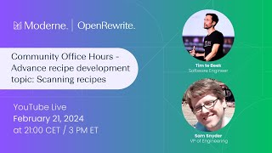
Recipes across files
docs.openrewrite.org/authoring-recipes/writing-recipes-over-multiple-source-file-types

Slide 30

Data tables
docs.moderne.io/user-documentation/moderne-platform/getting-started/data-tables

Slide 31

Multiple library versions
docs.openrewrite.org/authoring-recipes/multiple-versions

Slide 32
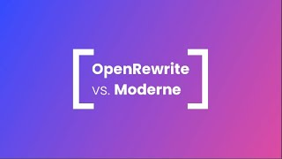
Notes:
OpenRewrite works well on a single project, that fits into memory.
Building up the LST model takes up most of the time; recipes are fast.
When you have large, or a lot of projects, then you’ll want to look at Moderne.
Moderne serializes LSTs to disk, allowing for novel use cases beyond OpenRewrite.

Slide 33
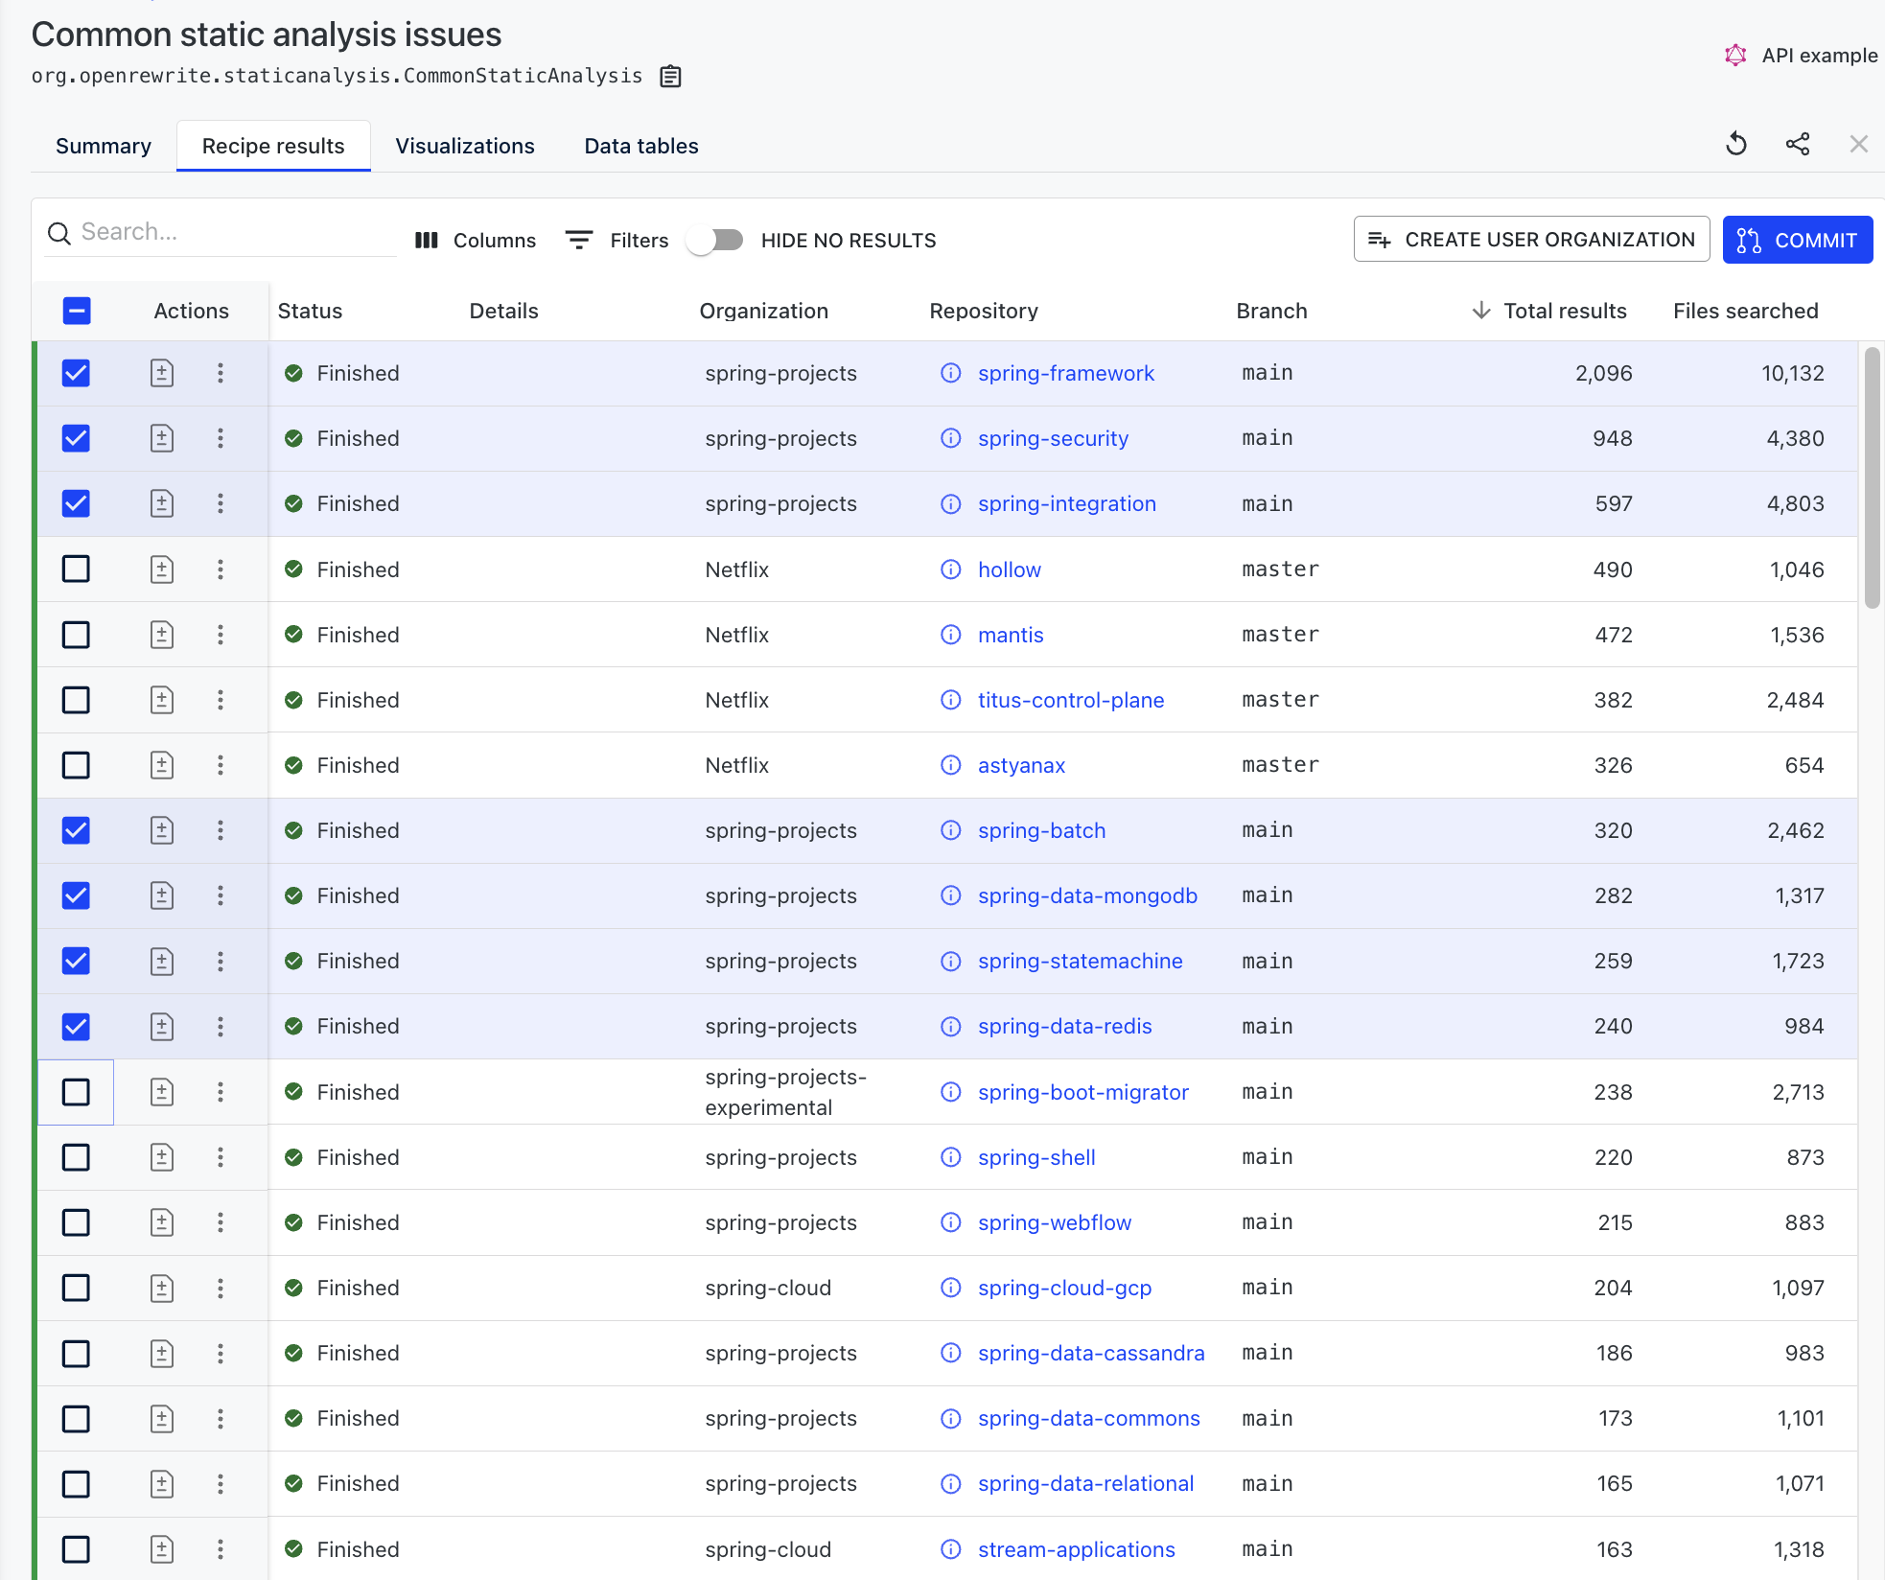
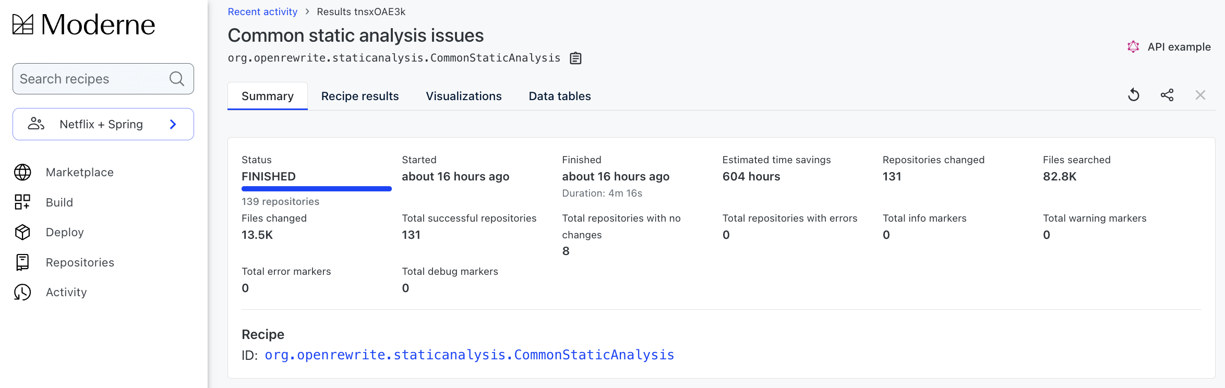
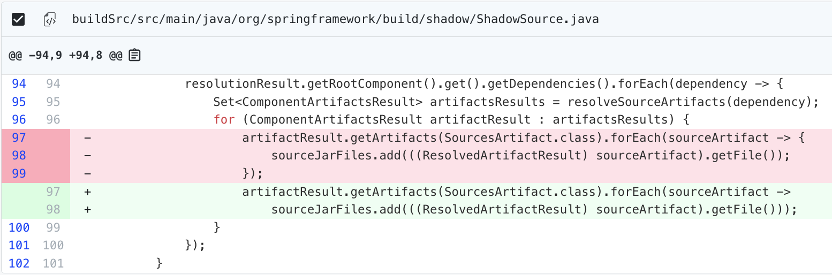
Moderne Platform: Auto-refactoring and analysis at scale
139 repositories searched
131 repositories changed (13,500 files)
Time to fix: 4 minutes and 16 seconds
Developer time saved: 604 hours (75 days)
Notes:
What does mass scale automated code refactoring look like in practice?
The Moderne platform enables you to see your codebase across 100s to 1000s of repos and make accurate automated changes to the relevant files in those repos.
In this example, Moderne was focused on finding static analysis issues in 139 repos. We were able to automatically fix issues in 13,500 files in just over 4 minutes. A developer can then check the diff and do a mass commit. If this were developers spending 3-5 minutes per issue, this would take around 75 days to complete the changes.

Slide 34
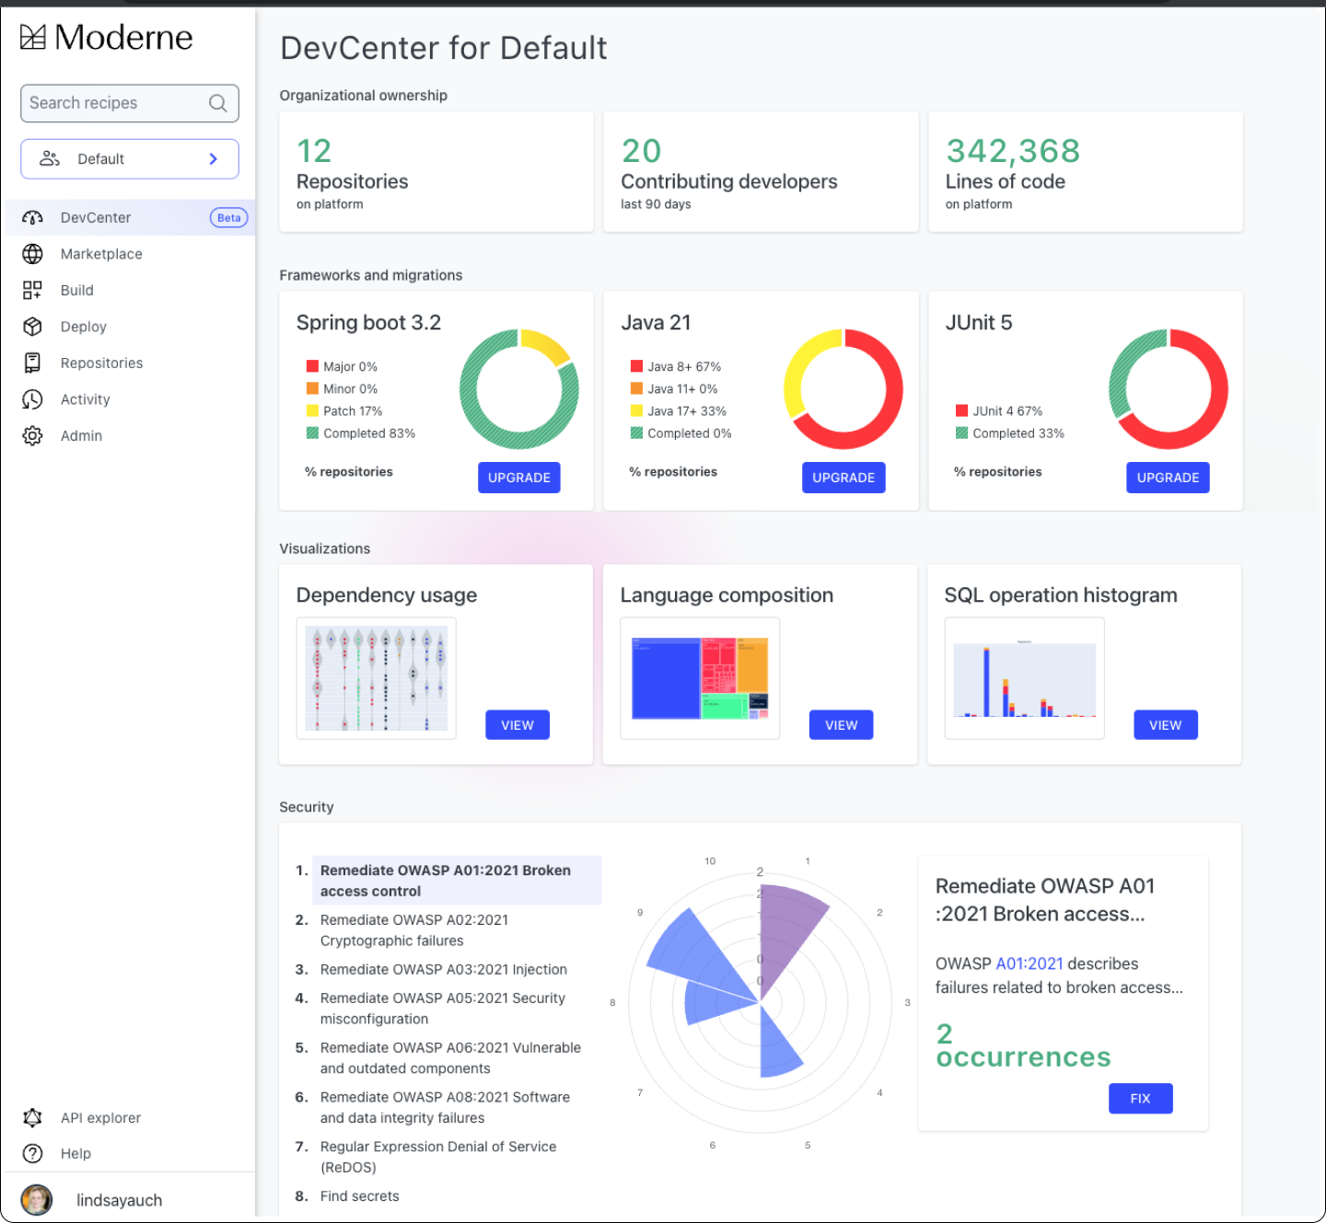
Moderne DevCenter
Collaborating across the
enterprise codebase
Dashboard view of the codebase tailored to organization/repository.
Tracking and driving upgrades for key framework migrations.
Showcasing important code visualizations to aid impact analysis.
Watching for critical vulnerabilities and enabling immediate fixes when they are available.
Notes:
At Moderne, we want to help your teams tackle these hard technical debt problems and to drive substantive action across organizations. That's why we're excited to announced the Moderne DevCenter dashboard as part of our platform to showcase these hard technical debt problems and to drive substantive action for organizations.
This is a place where developers can collaborate to make code better all the time.
With the DevCenter, those months-long framework migrations are a thing of the past. Instead, you can track the progress of software migrations—and automatically upgrade lagging projects. This can be a major framework upgrade, like for the latest Spring Boot version, a migration from one technology to another, or even a migration to cloud-native tech.
Instead of lengthy, expensive impact analysis efforts (that are behind by the time they are completed)—with Moderne, you can automate important data collections specific to your codebase, such as its dependency usage—enabling you to analyze issues, understand impact and effort, and stay aligned all the time.
And instead of urgent security fixes that can consume your development teams for weeks on end, you can continuously keep an eye on your most critical security vulnerabilities (like the OWASP top 10), readily identify your high-risk areas, and fix the code immediately.
------------------------
Contributing developers: the number of unique people who have contributed any amount of code to any of the repositories

Slide 35
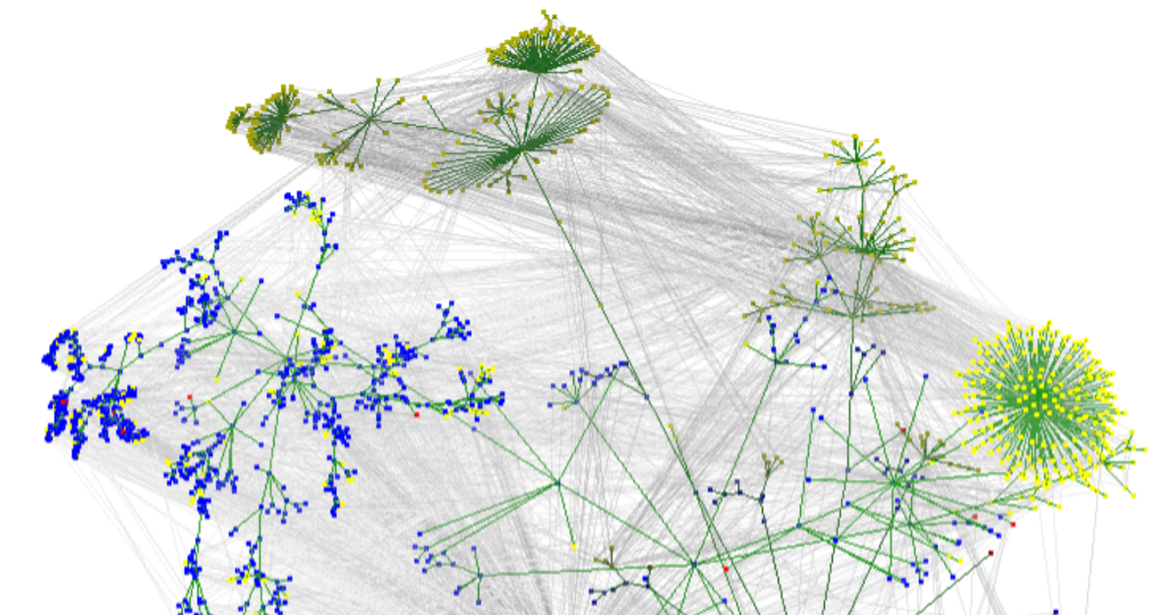
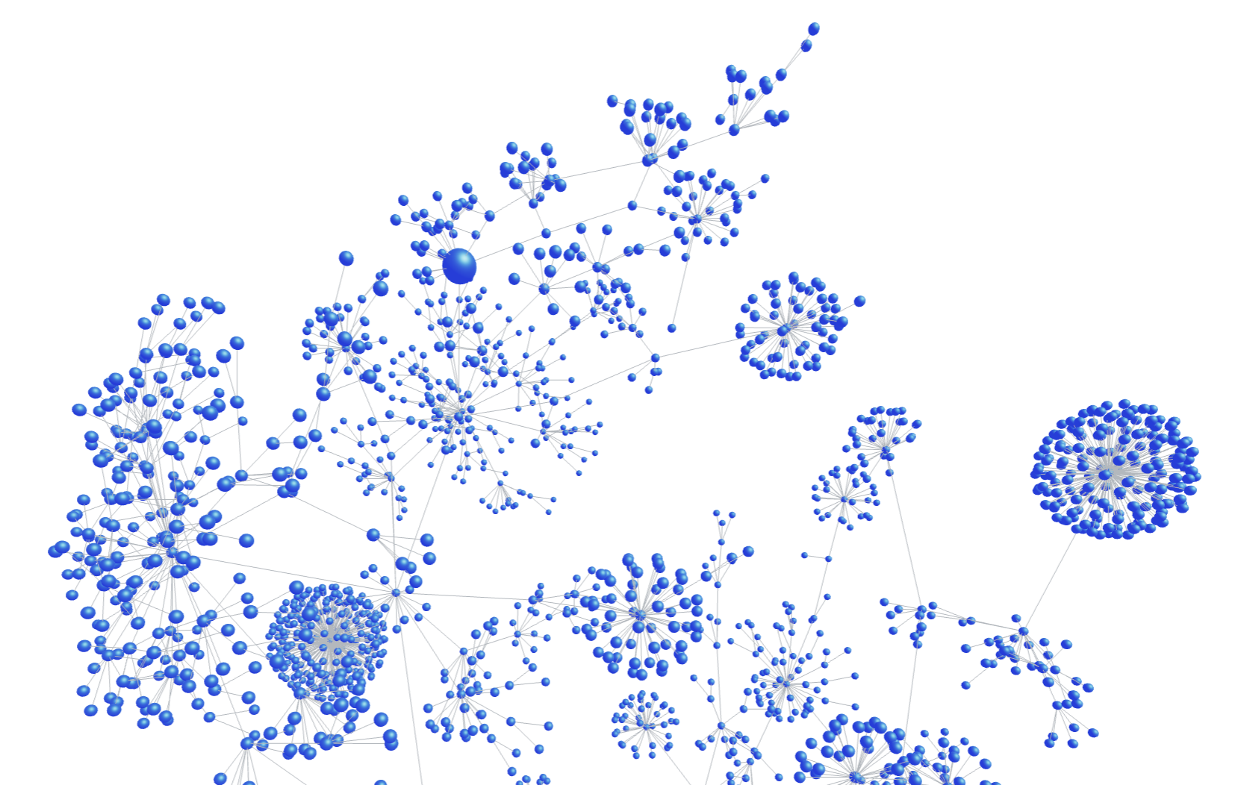
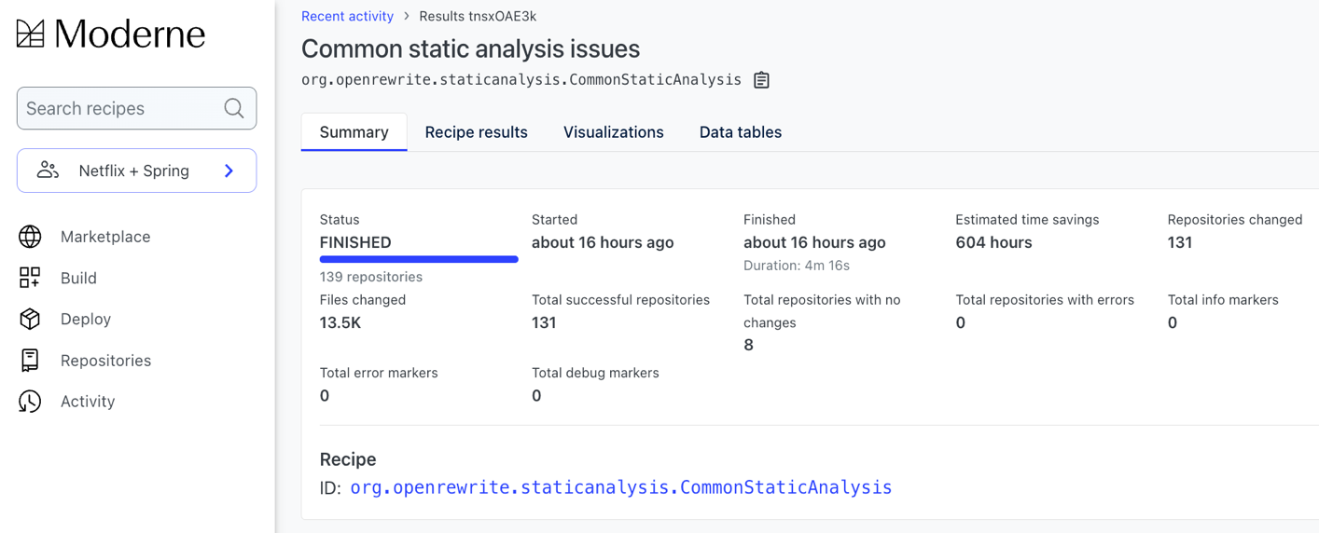
To change code at scale you need…
Full-fidelity model of the codebase
1
Open source auto-refactoring programs
2
Multi-repo distribution of code changes
3
Lossless Semantic Tree (LST)
A built artifact of code from a repo that includes type attribution, format preservation, and other metadata.
OpenRewrite recipes
Deterministic programs that accurately search and fix code by navigating to different parts of the LST tree.
LST serialization to disk
The ability to run recipes across multiple LSTs to affect change in 100s to 1,000s of repositories at once.
Notes:
There are three major components at work here that allow us to make these large-scale upgrades and security fixes.
First, we have the Lossless Semantic Tree or LST, which you can think of as analogous to an abstract syntax tree, but with a LOT more information – for instance, the lossless semantic tree contains all types in use across your application and all of its dependencies, as well as the full details of whitespace to make sure any changes made through this process are accurate and preserve your particular style. The first step in the process is to parse your code and turn it into this LST format.
Then, we run OpenRewrite recipes and other auto-refactoring technologies (such as JavaScript codemods) on this LST representation of your code to do impact analysis and make automatic changes. OpenRewrite recipes are deterministic programs. You will be able to trust that these recipes will make accurate changes, every time in every location.
And finally, we can work on your entire codebase at once with our unique IP. We are able to serialize the LSTs to disk, essentially distributing the work of running these refactoring technologies to worker nodes within our platform. This enables us to work across multiple repos as well as on very large mono-repos very efficiently and cost-effectively.

Slide 36
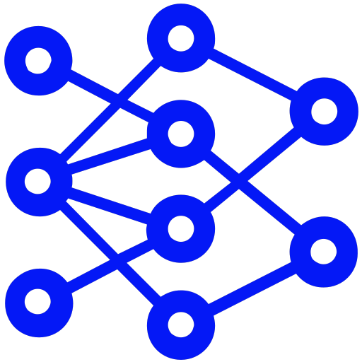
AI-supported multi-repo refactoring automation
FIND
ASSIST
DIAGNOSE
AI-powered recipe search
AI-assistant to recipes
AI recommending recipes
Human-computer interface
Helps users navigate the Marketplace catalog to find the right recipe they need.
“A computer gets AI.”
Leverages AI models within the rules-based recipe program to aid in the work of transformation.
Guiding AI to help with impact analysis and refactoring work.
“AI gets a computer.”
AI analyzes subsets of an organization’s code to recommend what recipes might be useful for fixing and upgrading their codebase.
Notes:
Moderne is able to integrate AI models very efficiently, cost-effectively, and accurately within our platform to support mass-scale auto-refactoring. We’re going beyond an AI assistant in a single-repository—it’s AI reimagined for multi-repository work.
We're currently bringing AI into the Platform in a few ways.
Added AI to our search function to enable users to use natural language instead of exact match to discover recipes that could be helpful.
Embedded calls to AI models within recipes to do focused tasks. This way, the rules-based recipes are asking AI to assist with simple operations using specific context, making the results more accurate and efficient.
Leverage AI to review relevant subsets of code within the lossless semantic tree to diagnose issues in the code and recommend the right recipes that can fix the issues. These recommendations will be served up in the Moderne DevCenter.
Within the Moderne Platform, we’re able to choose the best open source AI models for the task at hand, and your code does not have to leave our secure Platform to leverage AI and get the work done.

Slide 37


Multi-tech, multi-repo code analysis and refactoring
Single-repository mode
Multi-repository mode
OpenRewrite Gradle Plugin
OpenRewrite OSS Project
Moderne Platform
OpenRewrite Maven Plugin
Single- tenant SaaS
Serialize LSTs to disk
On-prem
Spring Boot Migrator
Amazon Q Code Transformation
JetBrains IntelliJ IDEA
Microsoft VSCode
Moderne CLI
Moderne DX
Air-gapped service
Codemods, linters, & other refactoring tech
Moderne proprietary IP
Shared OSS recipe ecosystem
Notes:
Now we are also supporting other refactoring tech!

Slide 38


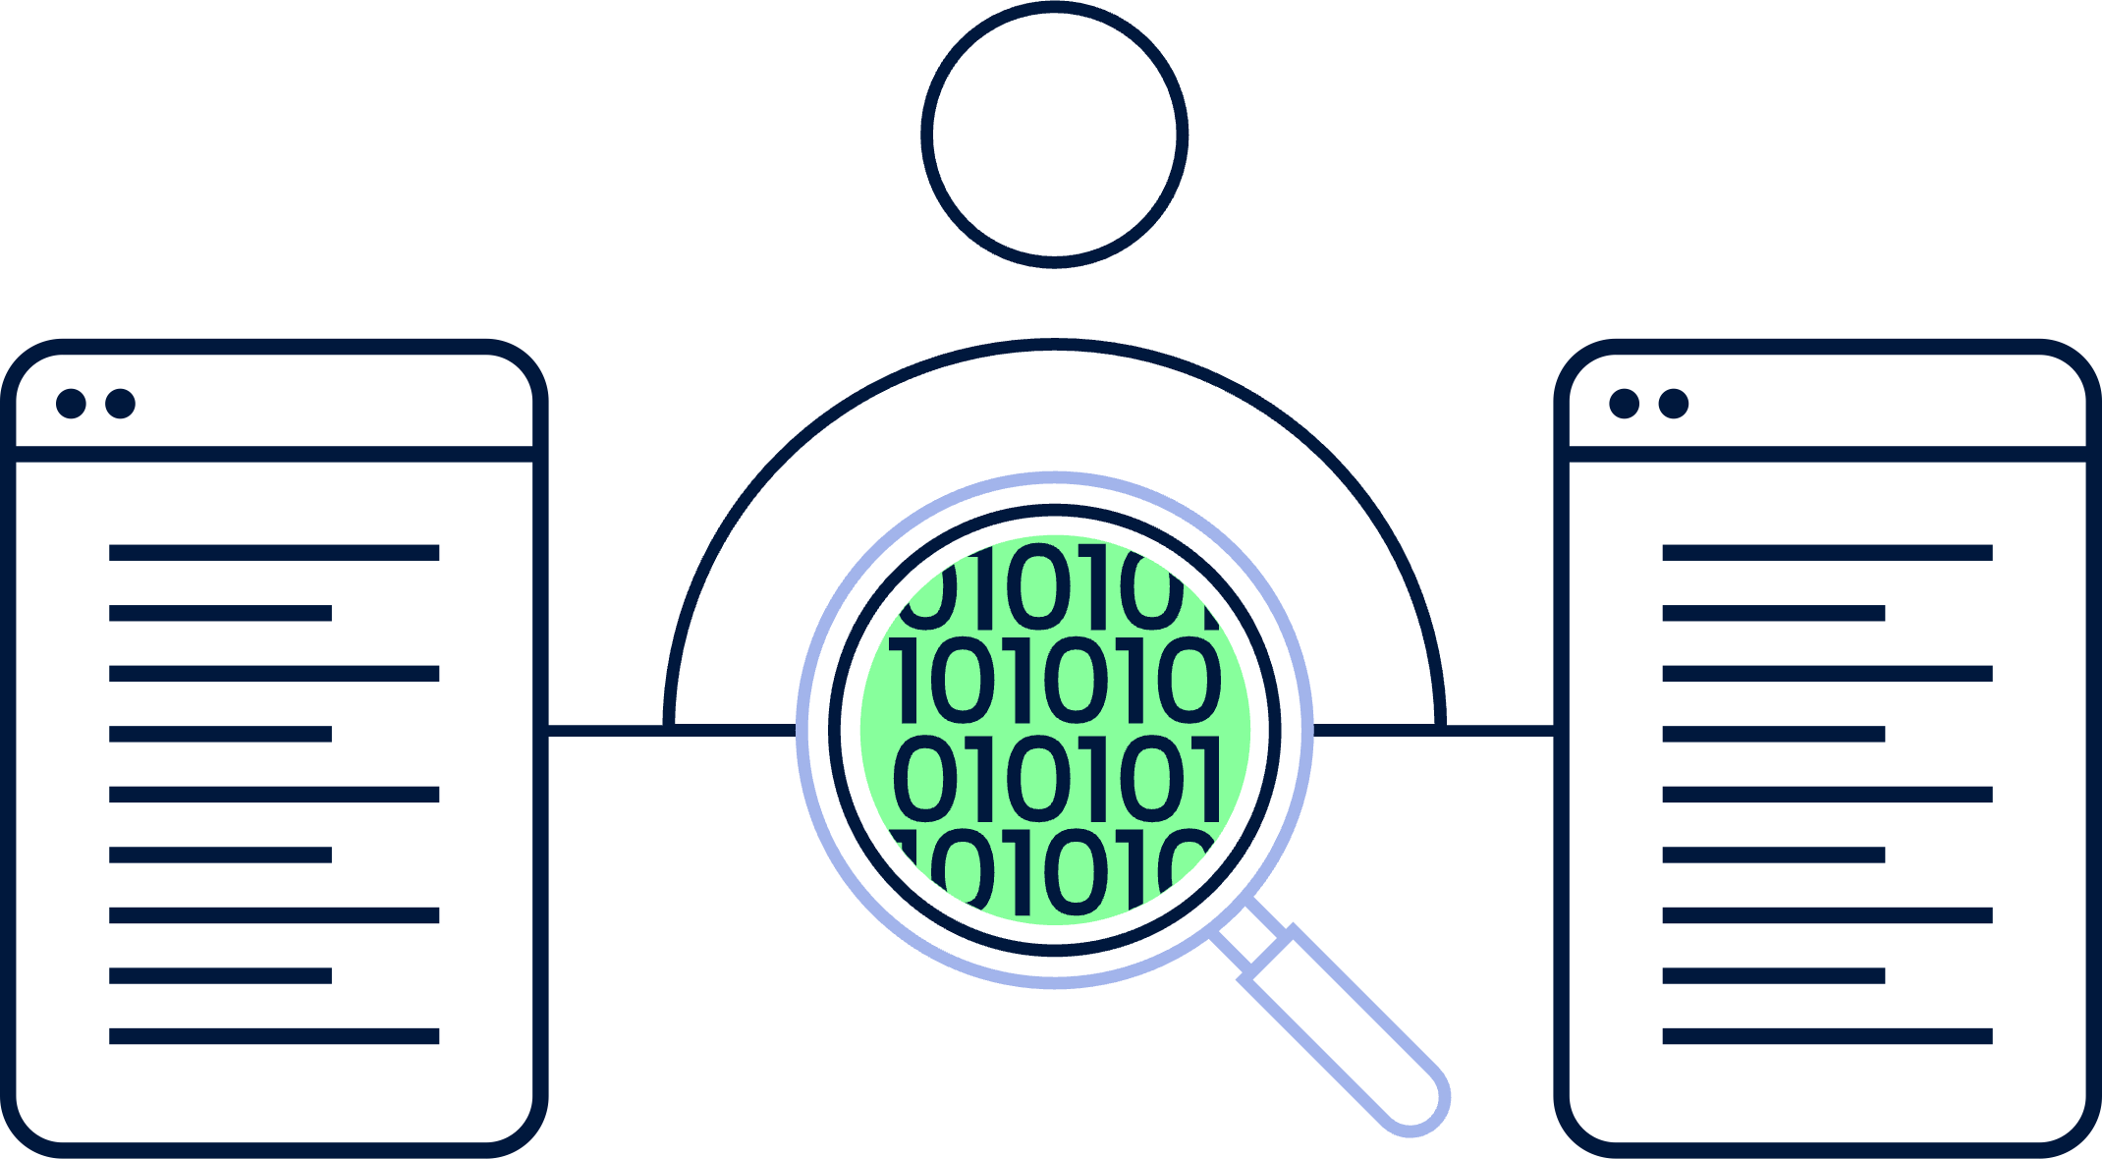
Moderne editions overview
Moderne Platform
Moderne DX
SaaS-driven code changes and analysis
ON-PREM / LOCAL
Moderne SaaS
Moderne DX Central Service
LOCAL
CLI-driven code changes and analysis
CLI-driven code changes and analysis
Moderne CLI
Moderne CLI
Moderne CLI
Moderne CLI
Moderne CLI
Moderne CLI
Enterprise-wide operations, global analysis, AI support via the SaaS console.
Code search, remediation, and analysis initiated from both SaaS and CLI.
Organizational operations and reporting via a Central Service.
Code search, remediation, and analysis initiated from the CLI.
TRY MODERNE: app.moderne.io
LEARN MORE: moderne.io/contact-us
Notes:
Our full-featured SaaS platform is available in Standard and Enterprise editions. Both editions provide the same robust

Slide 39
Moderne specific
Extract data across projects
Running your first recipe
Recipe builder
Data tables
Chart outcome of recipe runs
Visualizations
Track progress towards goals
Devcenter
Requires license for non OSS projects
Moderne CLI

Slide 40
Where to go from here

Slide 41

Dive into topics
To run recipes
Learn more
Get involved
Instructions
Recipe catalog
Migrate Spring Boot
Maintain OSS projects
app.moderne.io/ devcenter
Concepts
docs.openrewrite.org/concepts-explanations
Write recipes
docs.openrewrite.org/authoring-recipes
Join our Slack
Browse good first issues
Community office hours
docs.moderne.io/user-documentation
Notes:
From here there’s different ways for you to go;
Some will want to focus on running and composing existing recipes.
There’s various ways to do so, and happy to help you achieve your goals there.
Others will want to learn more in detail about particular topics;
the middle column will help you there.
Finally others might want to follow up and/or get involved;
the links to the right help you there.

Slide 42
Create your own Rewrite recipe module through
github.com/moderneinc/rewrite-recipe-starter
Notes:
Either way we recommend you start your own recipe library using our template.
That way you can save your work and share those recipes with colleagues.
The starter module also contains various example recipes,
and hints at how to alter those to learn more,
and create your own recipes.

Slide 43
Prerequisites
IntelliJ 2024.1+ ultimate (ideally)
Java 8 JDK, or 11, 17, 21
Maven 3.2+ or Gradle 4.10+
github.com/moderneinc/rewrite-recipe-starter

Slide 44
Exercise: A warning is just an error in the making
Replace `log.warning(“message”)` with `log.error(“message”)`
Using a declarative YAML recipe
Match any arguments
Replace `log.warning(“message”)` with `log.error(“message”)`
Using a Refaster style recipe
Write matching tests; prevent overfit to “message”
Replace `log.warning(“message”)` with `throw new IllegalStateException(“message”)`
Using an imperative Java recipe, and using JavaTemplate to throw
Expand to match `log.warning(“message”, exception)`

Slide 45


Where to learn more
docs.openrewrite.org/authoring-recipes
moderne.io
app.moderne.io
docs.moderne.io
moderne.io/blog
github.com/openrewrite
youtube.com/@moderne-auto-remediation
Notes:
Beyond that there’s various generic links where you can follow us.

Slide 46
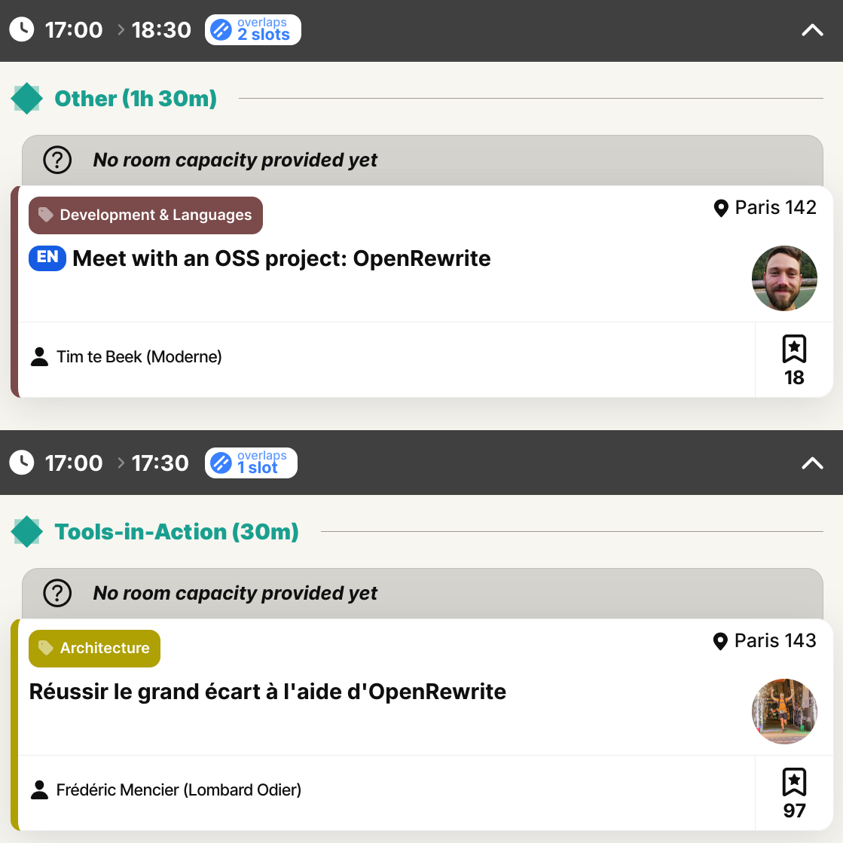
Today @ 17h
Notes:
And there’s even additional sessions at DEvoxx here today.
Frederic will show how to he’s used OpenRewrite to modernize a twenty year old application.
And if you have any questions we didn’t get to in the workshop, you can drop by from 17hr to 18:30 in Paris 142.

Slide 47



Merci!
Follow us!
Notes:
Thank you all for coming!
Don’t forget to pick us some swag and reach out if there’s ever anything I can help you with.

